Slide 1


An Introduction to Shiny
Allan Ritchie – ACR SOFtware

Slide 2

Allan Ritchie
Microsoft MVP
Former Xamarin MVP
Written a ton of Xamarin open source
Long time .NET developer
Lots of Azure – Had to say it, but saved it for last
blog: allancritchie.net
twitter: allanritchie911
twitch: allancritchie
github: aritchie

Slide 3
Agenda
The Challenges of Backgrounding & Device Access
What Exactly is Shiny?
How do I use it?
The Road Ahead
Resources
Q & A

Slide 4
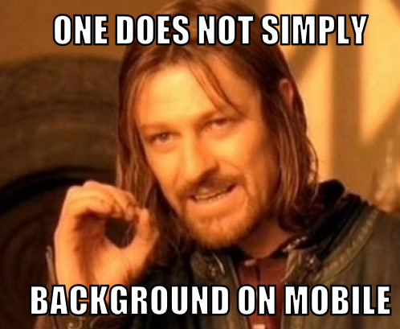
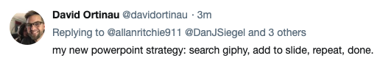
MEMES!

Slide 5
The Problems We Face
Each Platform does it differently
The OS is out to kill your process if you don’t behave
Plugins are designed to bring you the device access to your services, but backgrounding requires the reverse
As .NET Developers – we want things like async/await & dependency injection
iOS
Delegates = Delegates Everywhere
Do you stuff quick or forever face the wrath of iOS
30 seconds and not a penny more
Android
You have to spin it all back up yourself
Services or Broadcaster Receivers?
COUGH…. Someone said UWP – focus people

Slide 6
The Platforms
iOS
* Delegates
Android
* Broadcast Receivers
* Foreground Services
* Intent Services… ?
UWP
* Background Tasks
* Triggers
Xamarin
Async/Await
Events
Timers

Slide 7
Shiny to the Rescue
Centralized Infrastructure/Hosting
Centralized Eventing via Delegates
Dependency injection out of the box
Built-In Logging
Built-In Persistence
Built with Reactive patterns (RX)
Not a Plugin

Slide 8
The “Essentials”
Environment
Connectivity
Periodic Background Jobs
File System Helpers
Settings (with an extra touch of neat)
Caching

Slide 9
Beyond the Essentials
BluetoothLE Central & Peripheral Modes
Beacons
GPS & Geofencing
HTTP Transfers
Sensors

Slide 10

CODING TIME!!!

Slide 11
The Road Ahead
More Platforms
WebAssembly – Uno, Blazor, WebAssembly
Tizen
macOS
IOT - Meadow
More BLE
Vast Simplification
GATT Server will look like API Controllers
Make the client “Refit” style

Slide 12
Resources
https://github.com/shinyorg
https://github.com/aritchie
https://shinylib.net
https://allancritchie.net

Slide 13
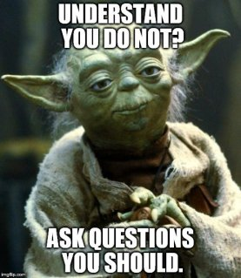
Q&A

